Slide 1
English
Unit 2 – Sport
WALT:
6Wc.01: Write, with support, short texts which describe people, places and objects, and routine past and present actions and events.

Slide 2



WALT: Write, with support, short texts which describe people, places and objects, and routine past and present actions and events.
I can include dates and statistics in my biography.
I can use the present simple and present perfect tense correctly in my biography.
I can include quotes correctly in my biography.

Slide 3
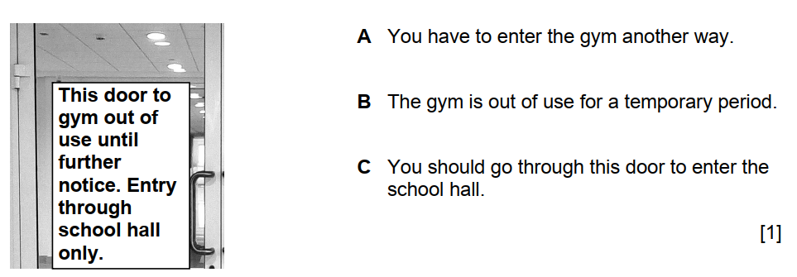
Retrieval Practice
WALT: Write, with support, short texts which describe people, places and objects, and routine past and present actions and events.

Slide 4

Starter – Two truths and a lie.
WALT: Write, with support, short texts which describe people, places and objects, and routine past and present actions and events.
Tell your partner 2 truths and 1 lie about the sports star you researched.
Can they guess which is the lie?

Slide 5
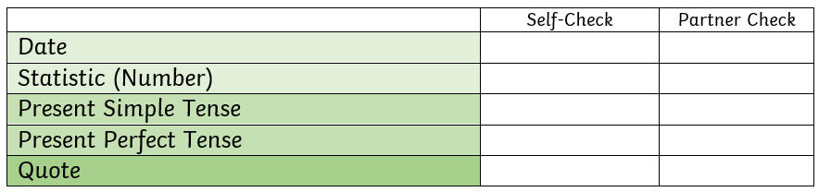
Use the planning you did last lesson to write a biography about the sports star you researched.
Use the example in the learner’s book to help you.
WALT: Write, with support, short texts which describe people, places and objects, and routine past and present actions and events.

Slide 6
Modelling
WALT: Write, with support, short texts which describe people, places and objects, and routine past and present actions and events.

Slide 7
Biography Writing Steps
WALT: Write, with support, short texts which describe people, places and objects, and routine past and present actions and events.
Step 1: Write your biography in your notebook.
Step 2: Use the checklist to check your work.
Step 3: Edit if necessary.
Step 4: Get your partner to check your work.
Step 5: Edit if necessary based on your partner’s suggestions.
Step 6: Get your teacher to check and correct your work.
Step 7: Write your final draft on paper.

Slide 8
WALT: Write, with support, short texts which describe people, places and objects, and routine past and present actions and events.
I can include dates and statistics in my biography.
I can use the present simple and present perfect tense correctly in my biography.
I can include quotes correctly in my biography.

